Slide 1
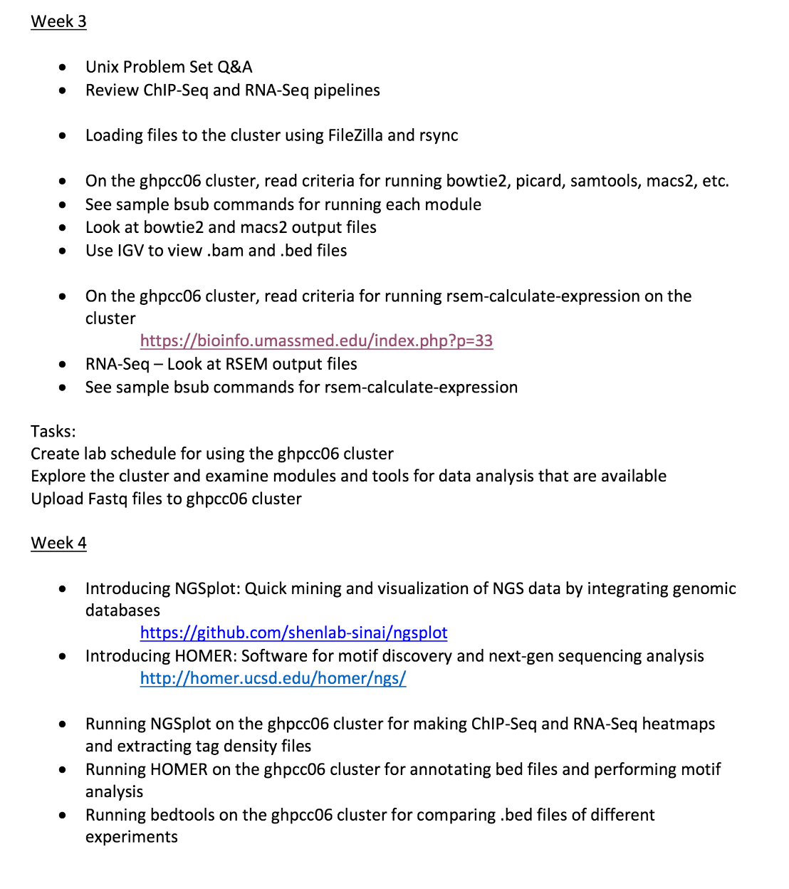

Slide 3
My ChIP-Sequencing Workflow
Raw Reads
fastq
.tdf to visualize
(IGV tools)
Map to genome (Bowtie2)
Bam Index (picard)
Sort Sam
(picard)
MAPQ filter (samtools)
Peak Analysis
(macs2)
Mark duplicates
(picard)
Merge runs
(picard)

Slide 4
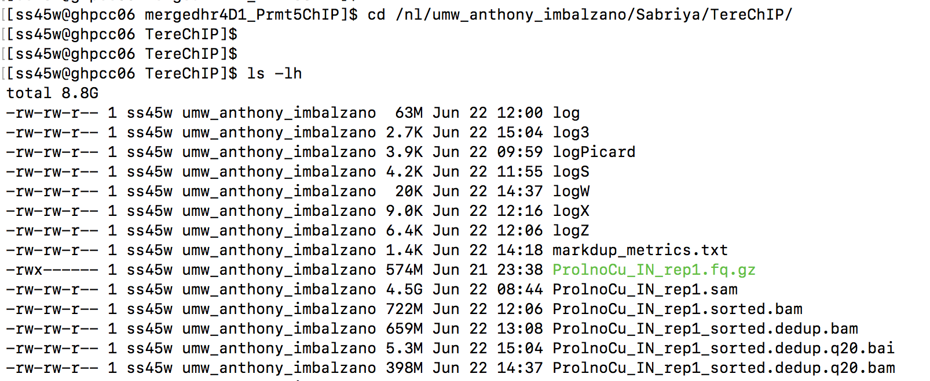

Slide 5
My ChIP-Sequencing Workflow
Raw Reads
fastq
.tdf to visualize
(IGV tools)
Map to genome (Bowtie2)
Bam Index (picard)
Sort Sam
(picard)
MAPQ filter (samtools)
Peak Analysis
(macs2)
Mark duplicates
(picard)
Merge runs
(picard)

Slide 6
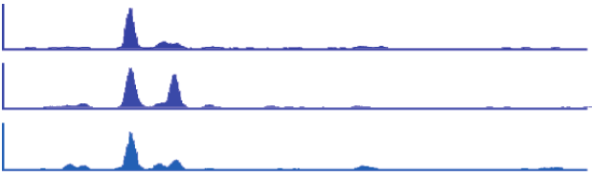
Binding profile
1 kb
Oct4
Nanog
Sox2
Oct4
(mouse Chr 17)
50 kb
H3K4me3
H3K36me3
FoxP1
(mouse Chr 3)
1 kb
RNAP II
ZFP36
(human Chr 19)
Kagey et al. (2010). Nature 467: 430
Mikkelsen et al. (2007). Nature 448: 553
Pepke et al. (2009). Nat. Methods 6: S22

Slide 7
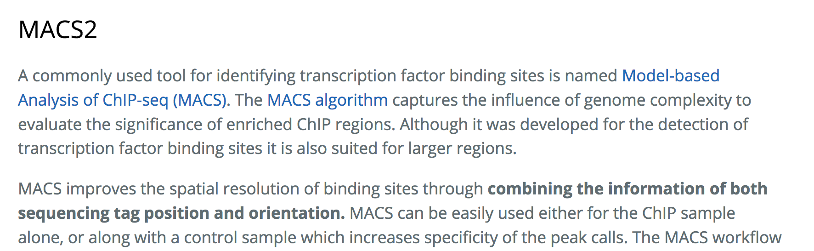
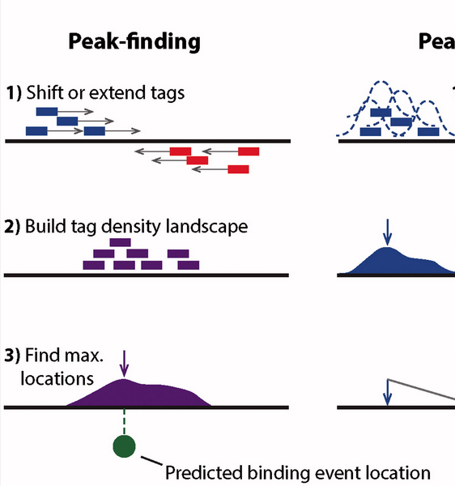
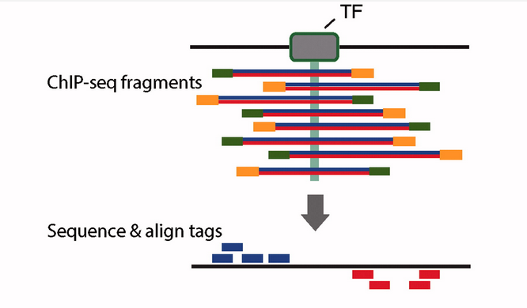

https://hbctraining.github.io/Intro-to-ChIPseq/lessons/05_peak_calling_macs.html
Mahony and Pugh, 2015, Critical Reviews in Biochemistry and Molecular Biology,
Volume 50, 2015 - Issue 4

Slide 8
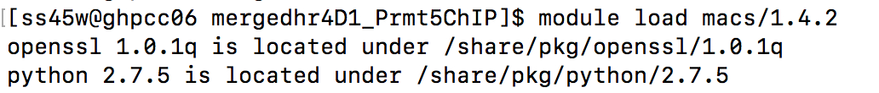
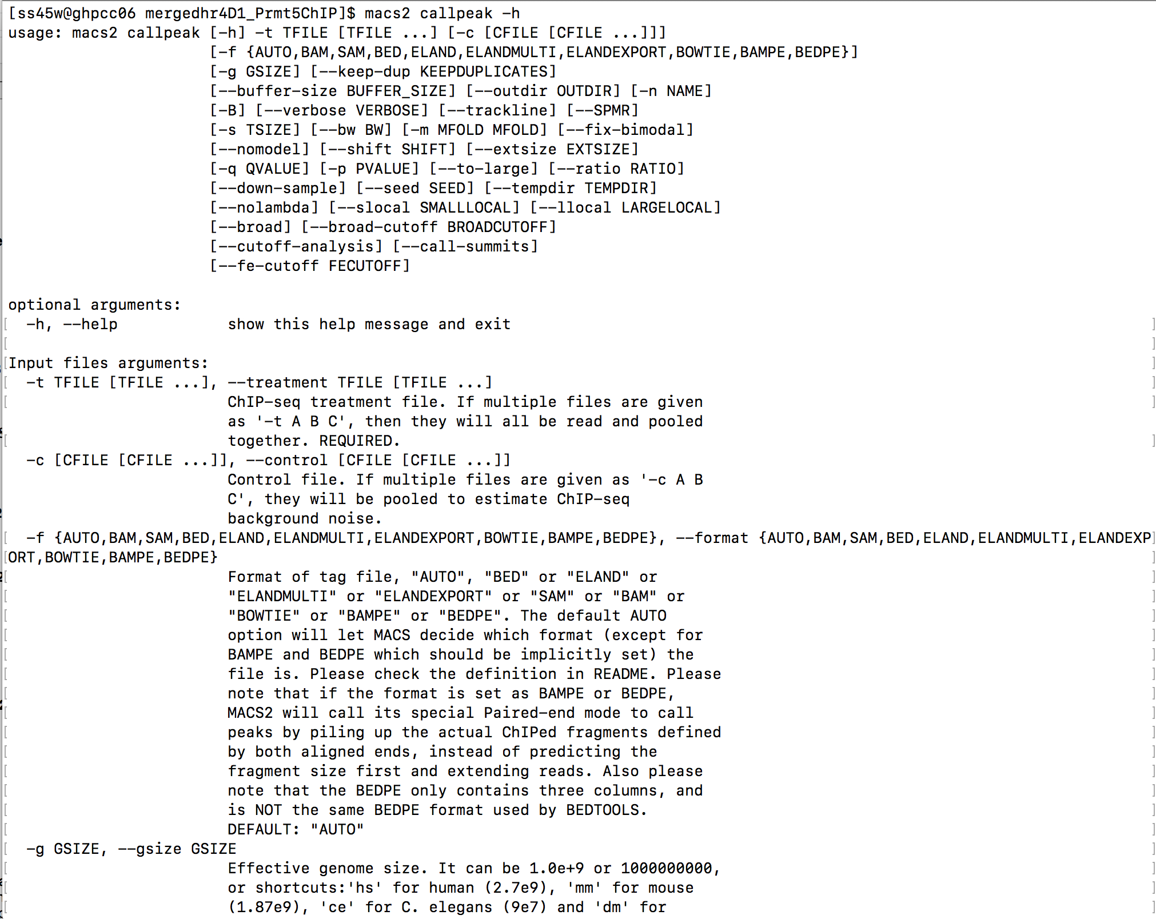

Slide 9
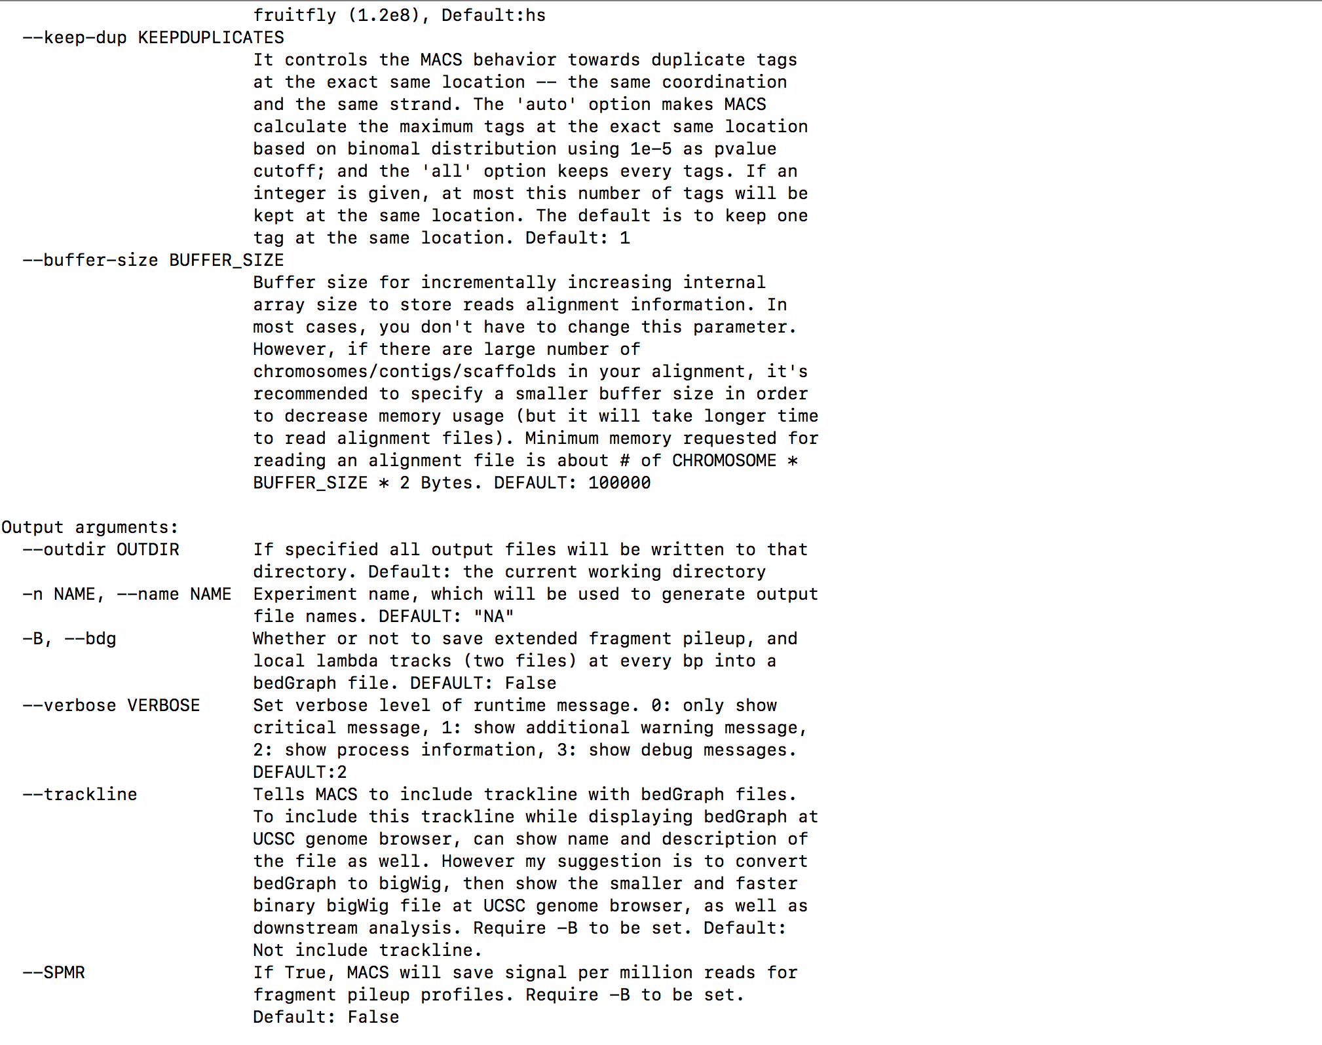

Slide 10
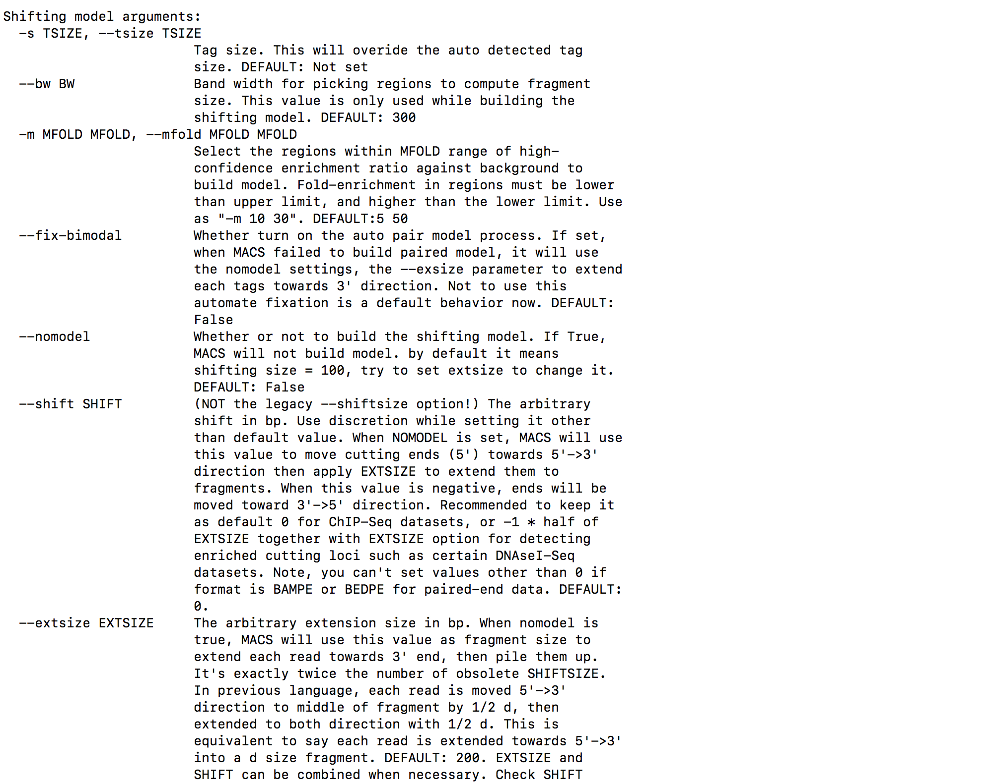

Slide 11
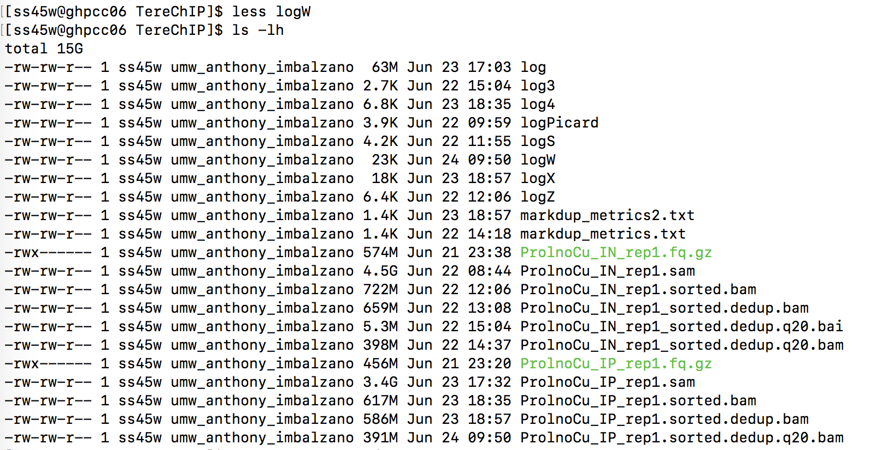

Slide 12
#Peak analysis
IP.sorted.dedup.q20.bam and Input.sorted.dedup.q20.bam --> .peak analysis using macs2
#example
module load macs/1.4.2
bsub -q short -o log5 -n 2 -R rusage[mem=20000] -W120 -R span[hosts=1] "macs2 callpeak -t ProlnoCu_IP_rep1.sorted.dedup.q20.bam -c ProlnoCu_IN_rep1_sorted.dedup.q20.bam -f BAM -g mm -q 0.05 -n ProlnoCu _rep1_q0.05"
If ChIP-Seq is paired-end:
bsub -q short -n 1 -R rusage[mem=20000] -W120 "macs2 callpeak -t ProlnoCu_IP_rep1_sorted.dedup.q20.bam -c ProlnoCu_IN_rep1_sorted.dedup.q20.bam -f BAMPE -g mm -q 0.05 -n D1Prmt5_n1n2_q0.05_PE"
For broader peaks, another option (but better broad peak software exists):
bsub -q short -o log -n 1 -R rusage[mem=20000] -W120 "macs2 callpeak -t ProlnoCu_IP_rep1_sorted.dedup.q20.bam -c ProlnoCu_IN_rep1_sorted.dedup.q20.bam -f BAM -g mm --broad --broad-cutoff 0.05 -n D2_H3k27me3_q0.1"

Slide 13
My ChIP-Sequencing Workflow
Raw Reads
fastq
.tdf to visualize
(IGV tools)
Map to genome (Bowtie2)
Bam Index (picard)
Sort Sam
(picard)
MAPQ filter (samtools)
Peak Analysis
(macs2)
Mark duplicates
(picard)
Merge runs
(picard)

Slide 14
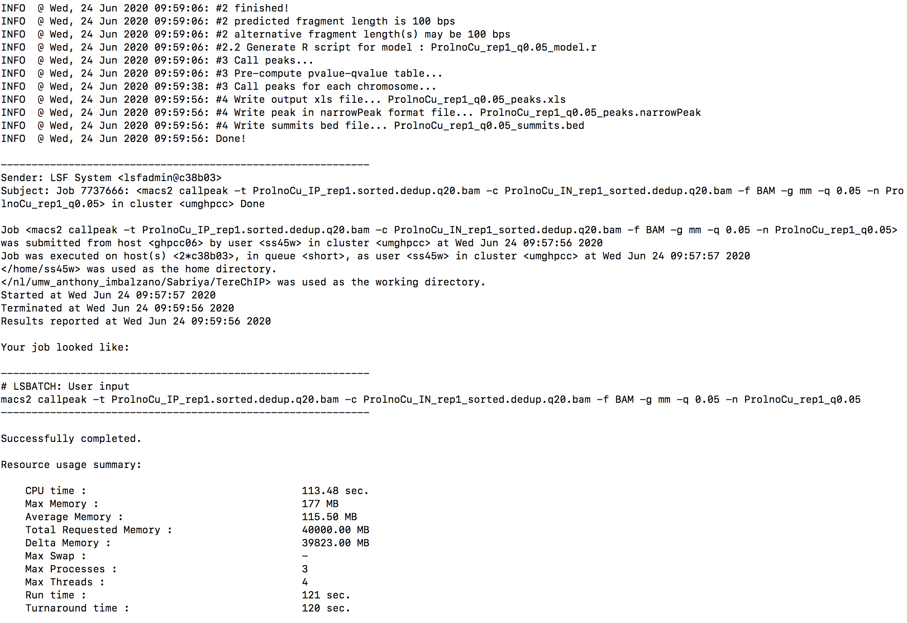
Run Report

Slide 15
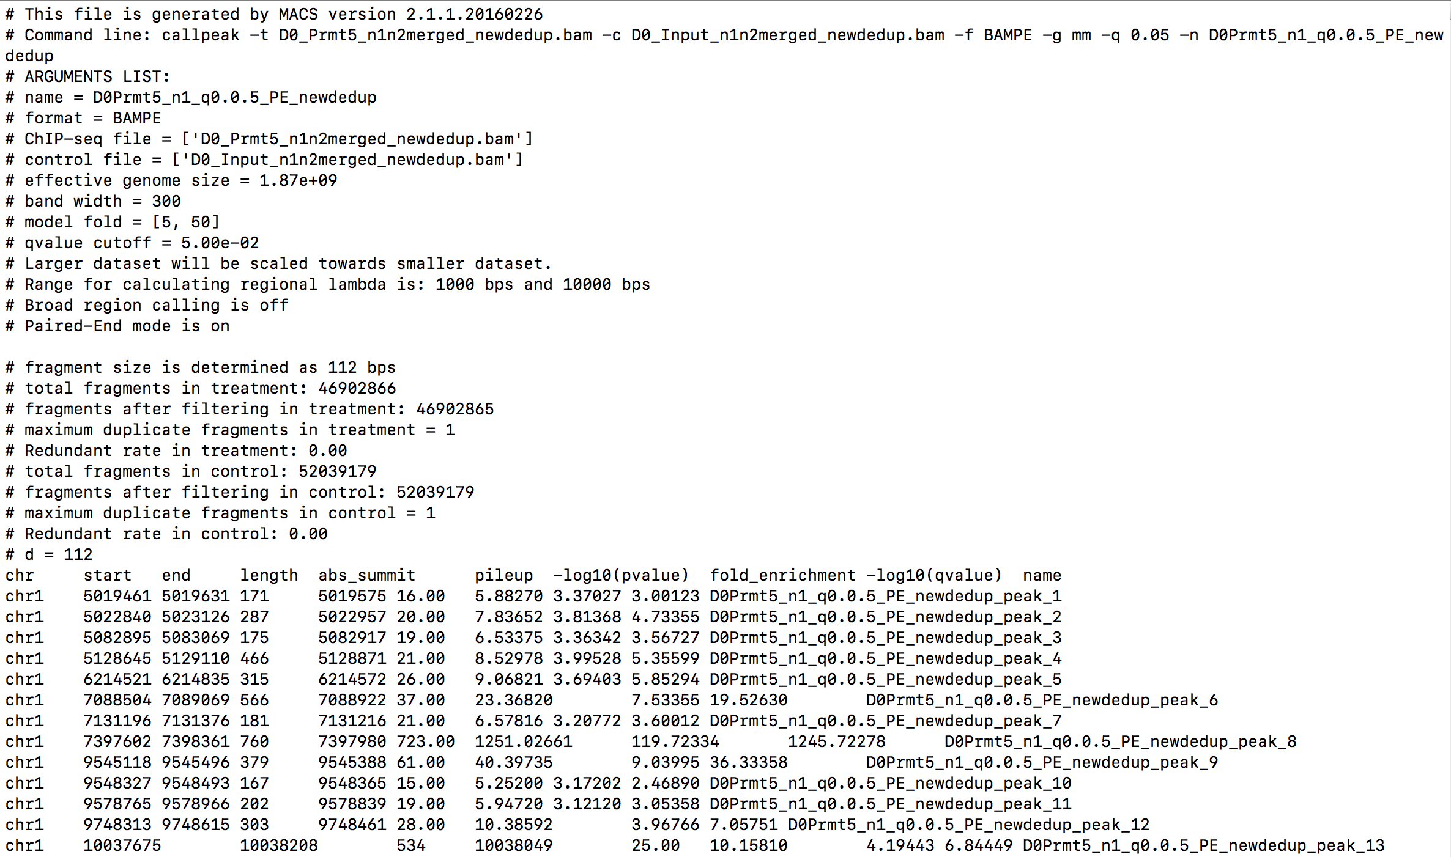
MACS output

Slide 16
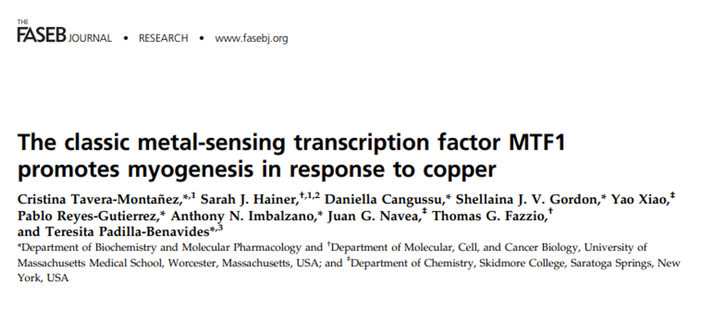
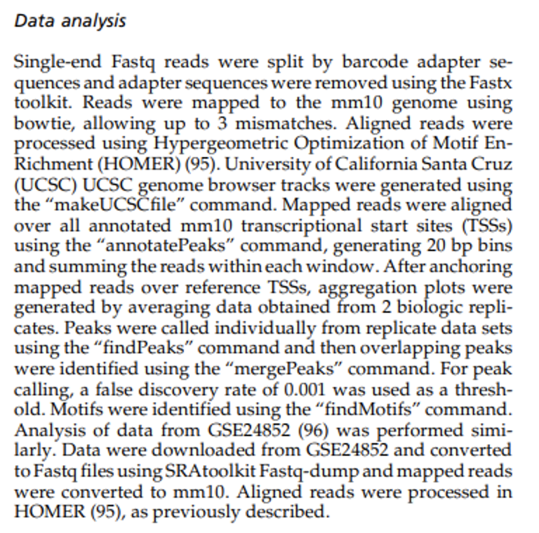

Slide 18
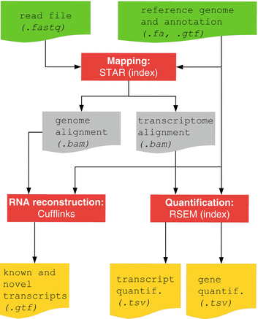
RNA-Seq Pipline
Methods and Tools
Bowtie and Bowtie2 use Burrows-Wheeler indexing for aligning reads. With bowtie2 there is no upper limit on the read length
Bowtie2
Bowtie2 to align reads in a splice-aware manner and aids the discovery of new splice junctions
RSEM is a software package for estimating gene and isoform expression levels from RNA-Seq data. The RSEM package provides an user-friendly interface, supports threads for parallel computation of the EM algorithm, single-end and paired-end read data, quality scores, variable-length reads and RSPD estimation.

Slide 19
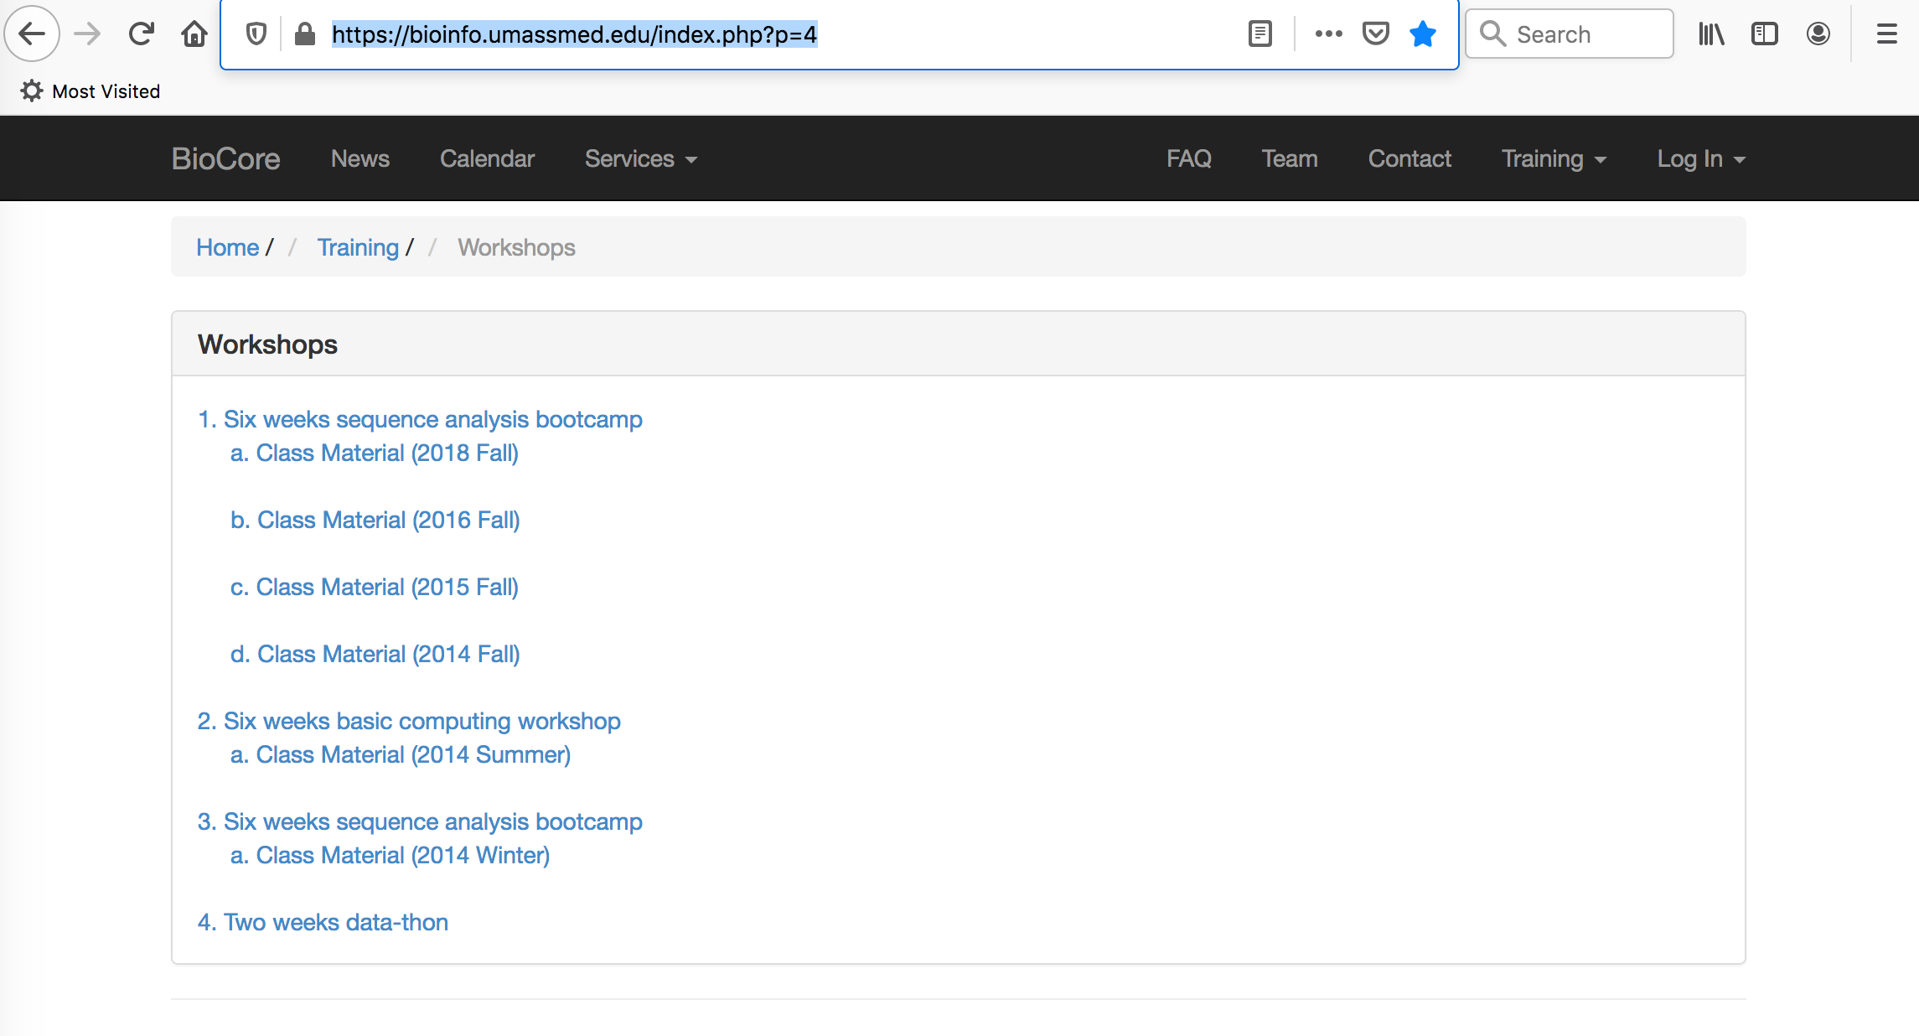
https://bioinfo.umassmed.edu/index.php?p=4

Slide 20
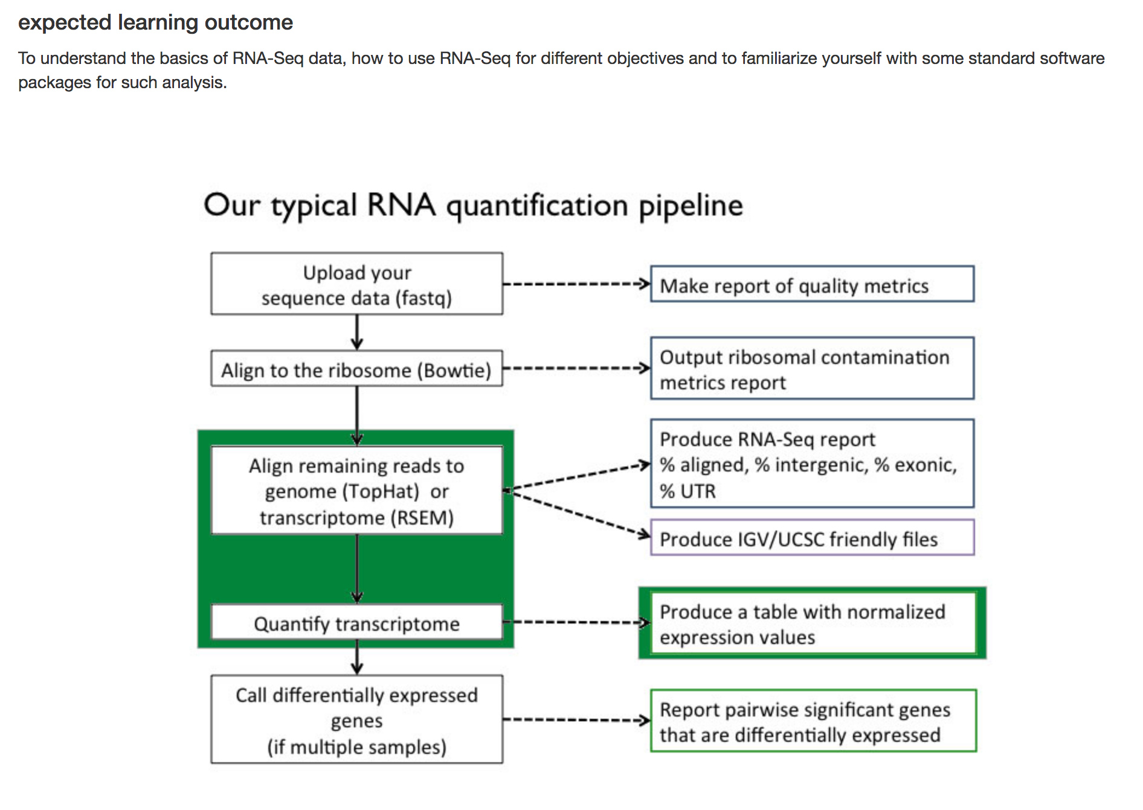
https://bioinfo.umassmed.edu/index.php?p=33

Slide 21
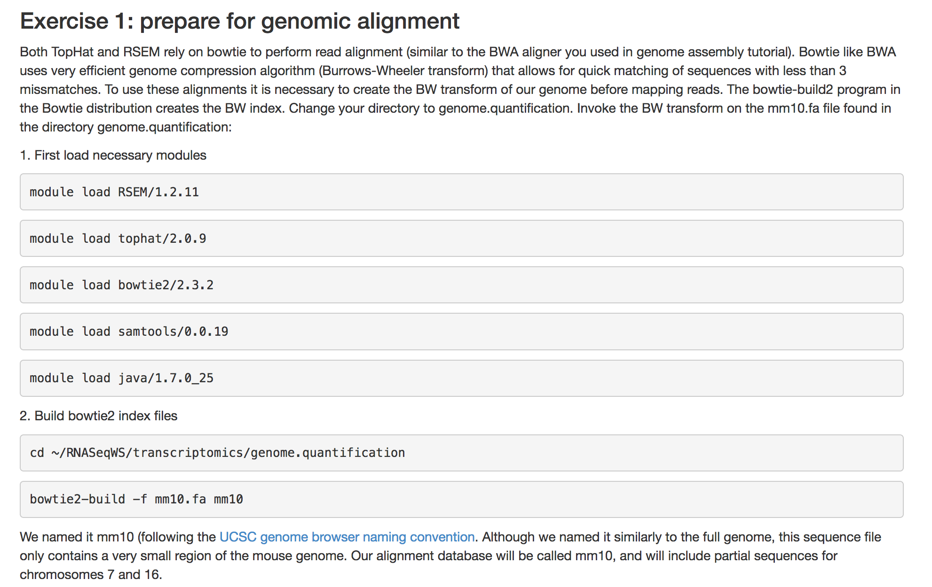
https://bioinfo.umassmed.edu/index.php?p=33

Slide 22
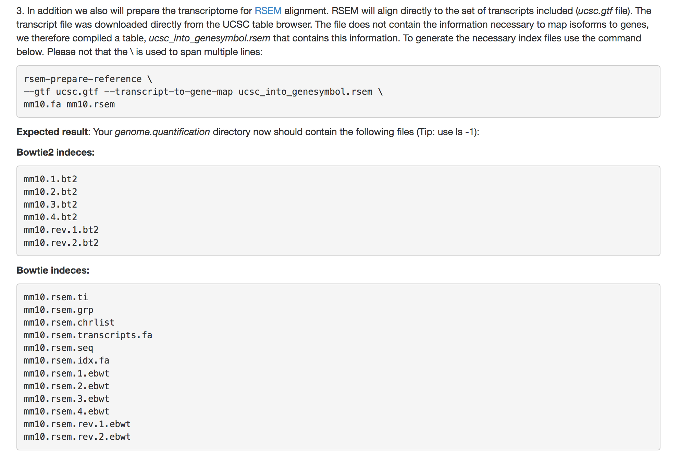
https://bioinfo.umassmed.edu/index.php?p=33
rsem-prepare-reference --gtf /path/to/trasncriptome/data/annotation.gtf --bowtie2 /path/to/trasncriptome/data/genome.fasta /nl/umw_anthony_imbalzano/Sabriya/RNASeq/output

Slide 23
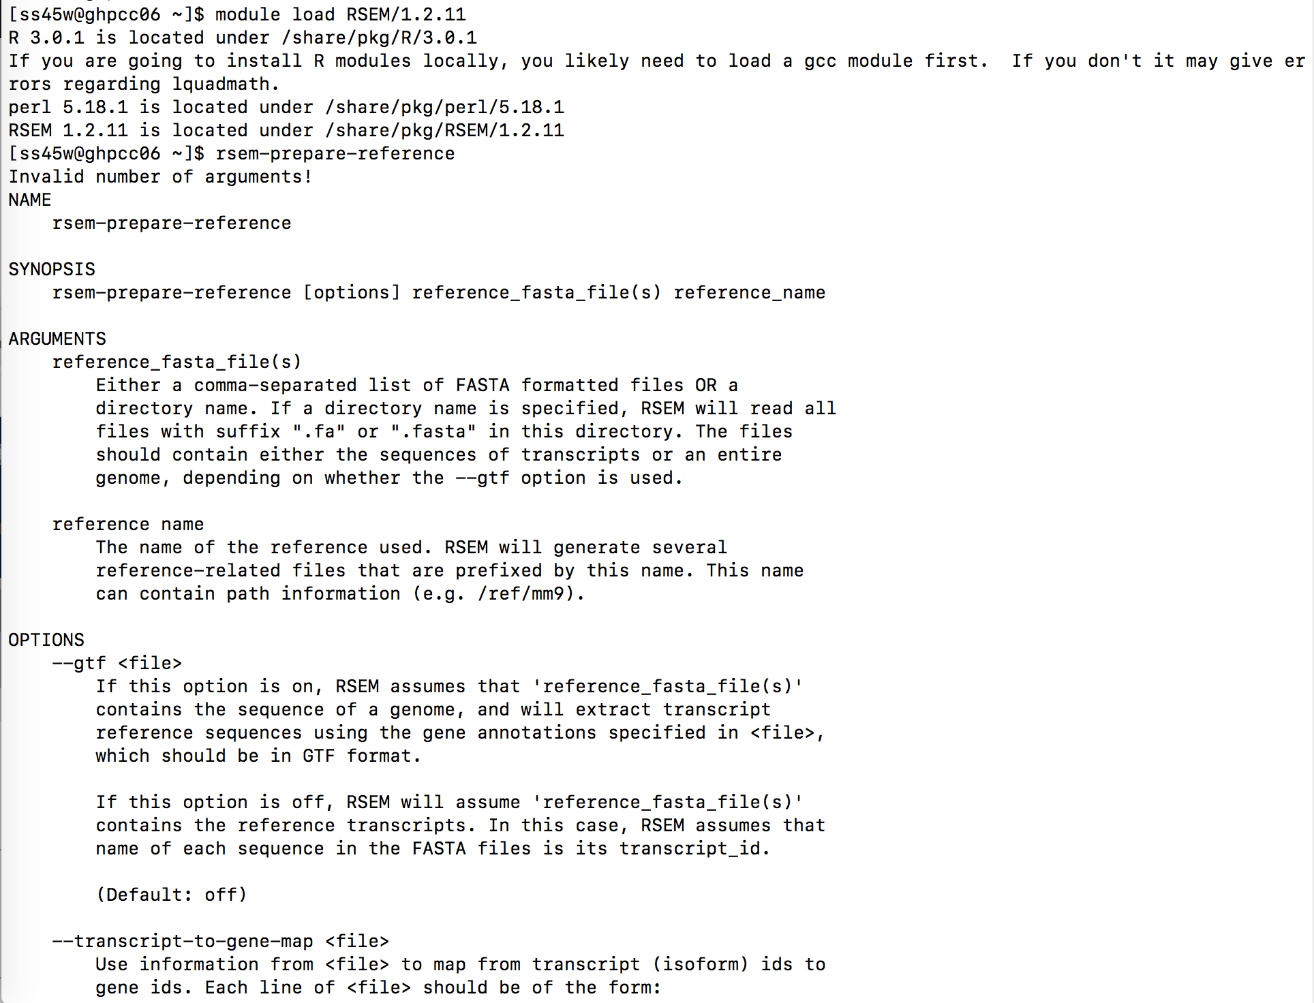

Slide 24
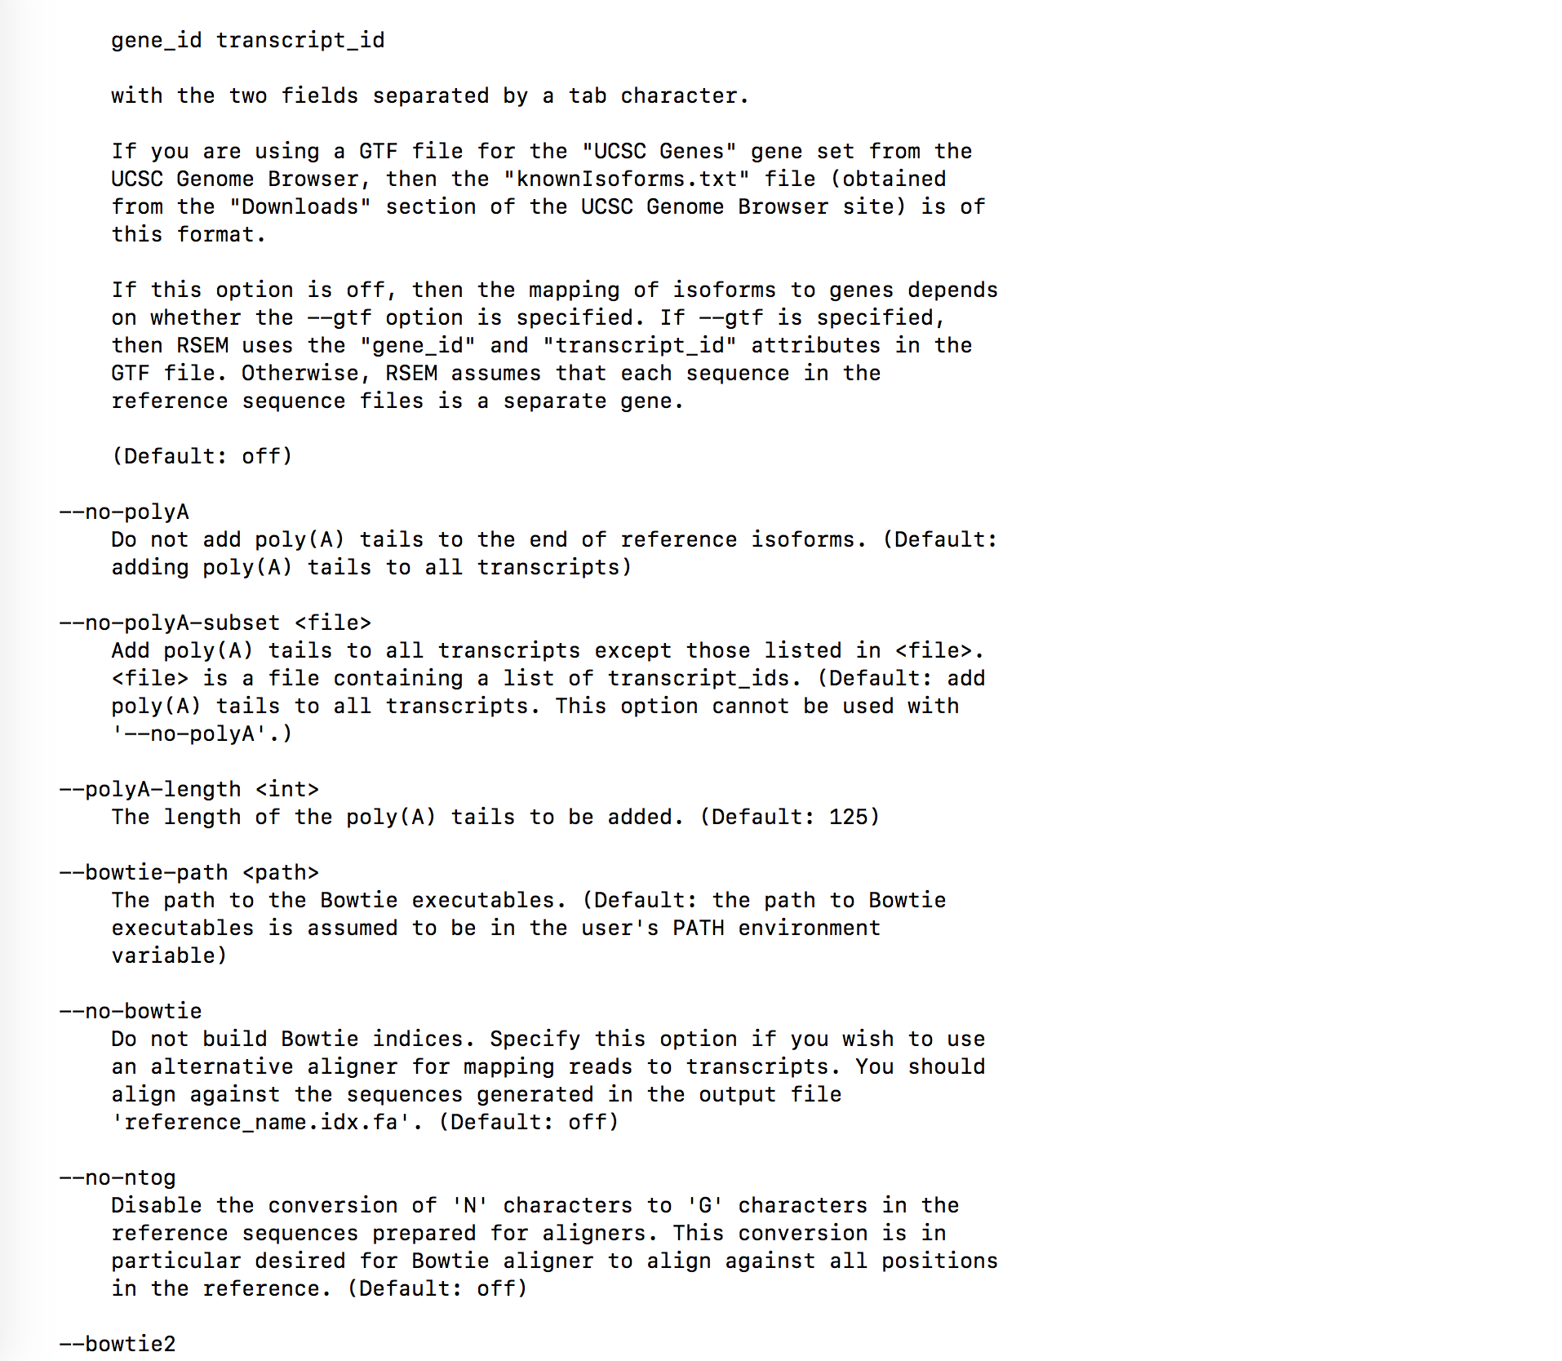
https://bioinfo.umassmed.edu/index.php?p=33

Slide 25
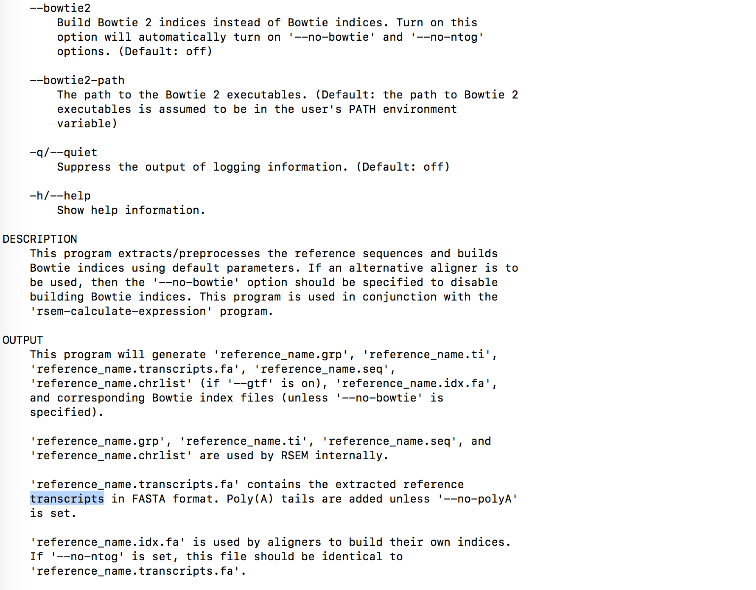

Slide 26
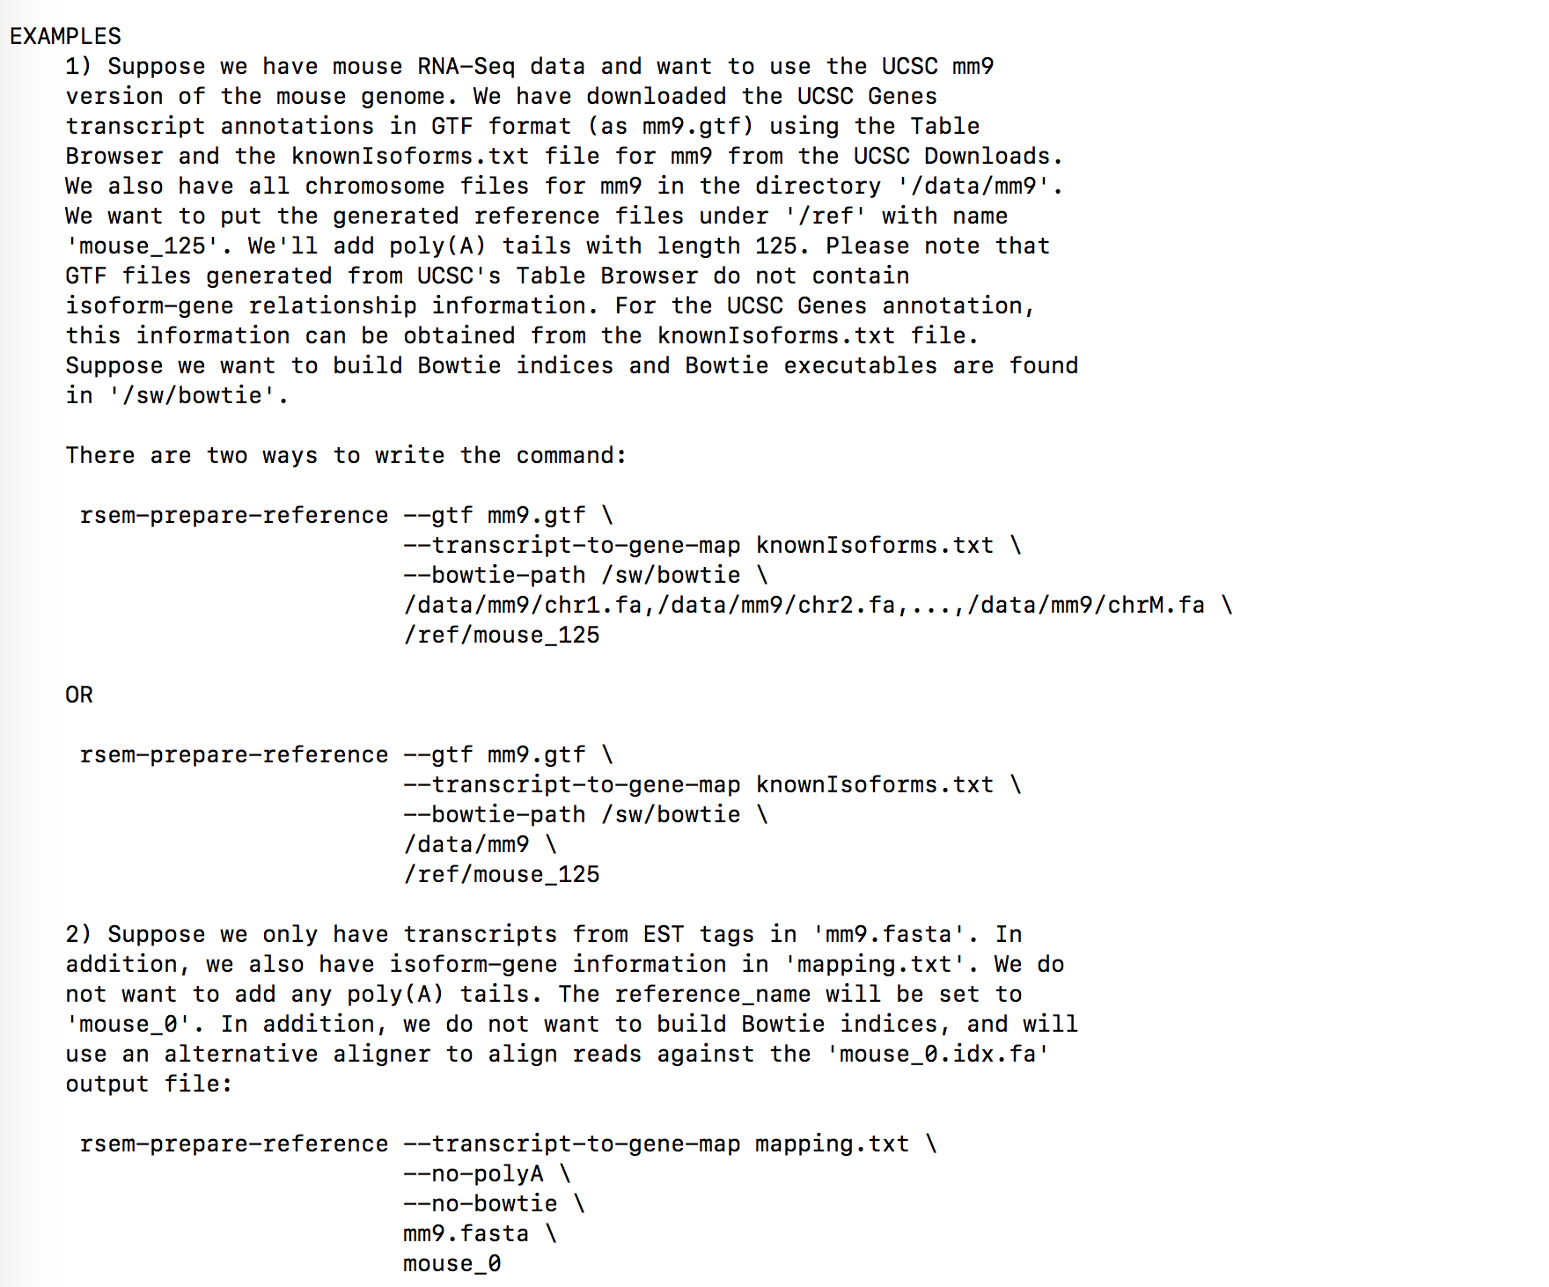

Slide 27
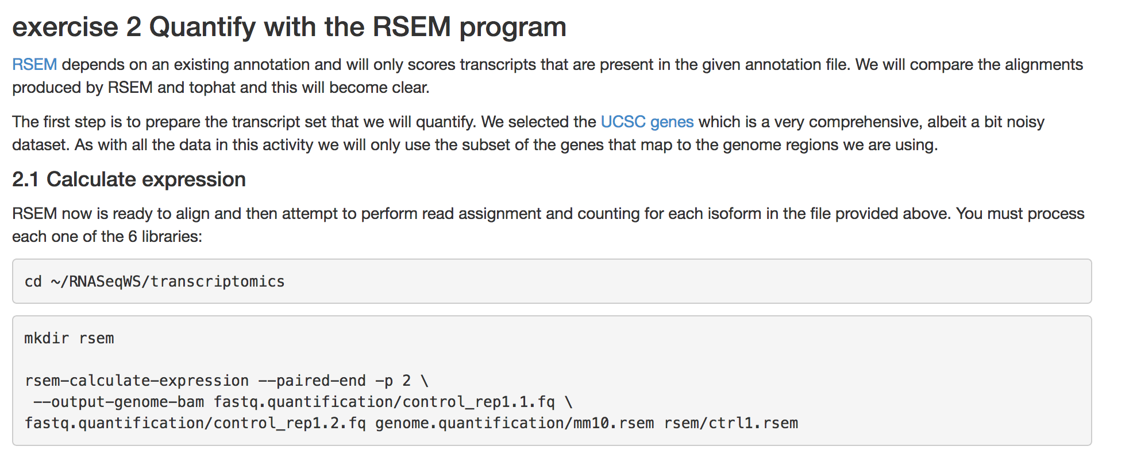
Single-end RNA-Seq analysis
bsub -n 1 -o logS -q long -R rusage[mem=80000] -W999 "rsem-calculate-expression --bowtie2 --num-threads 12 RNASeq/msAdiposeMSC_GSE116558_1_R1.fastq.gz RNASeq/mm10 RNASeq/AdiposeMSC_1_R1_ucsc_RSEM”

Slide 28
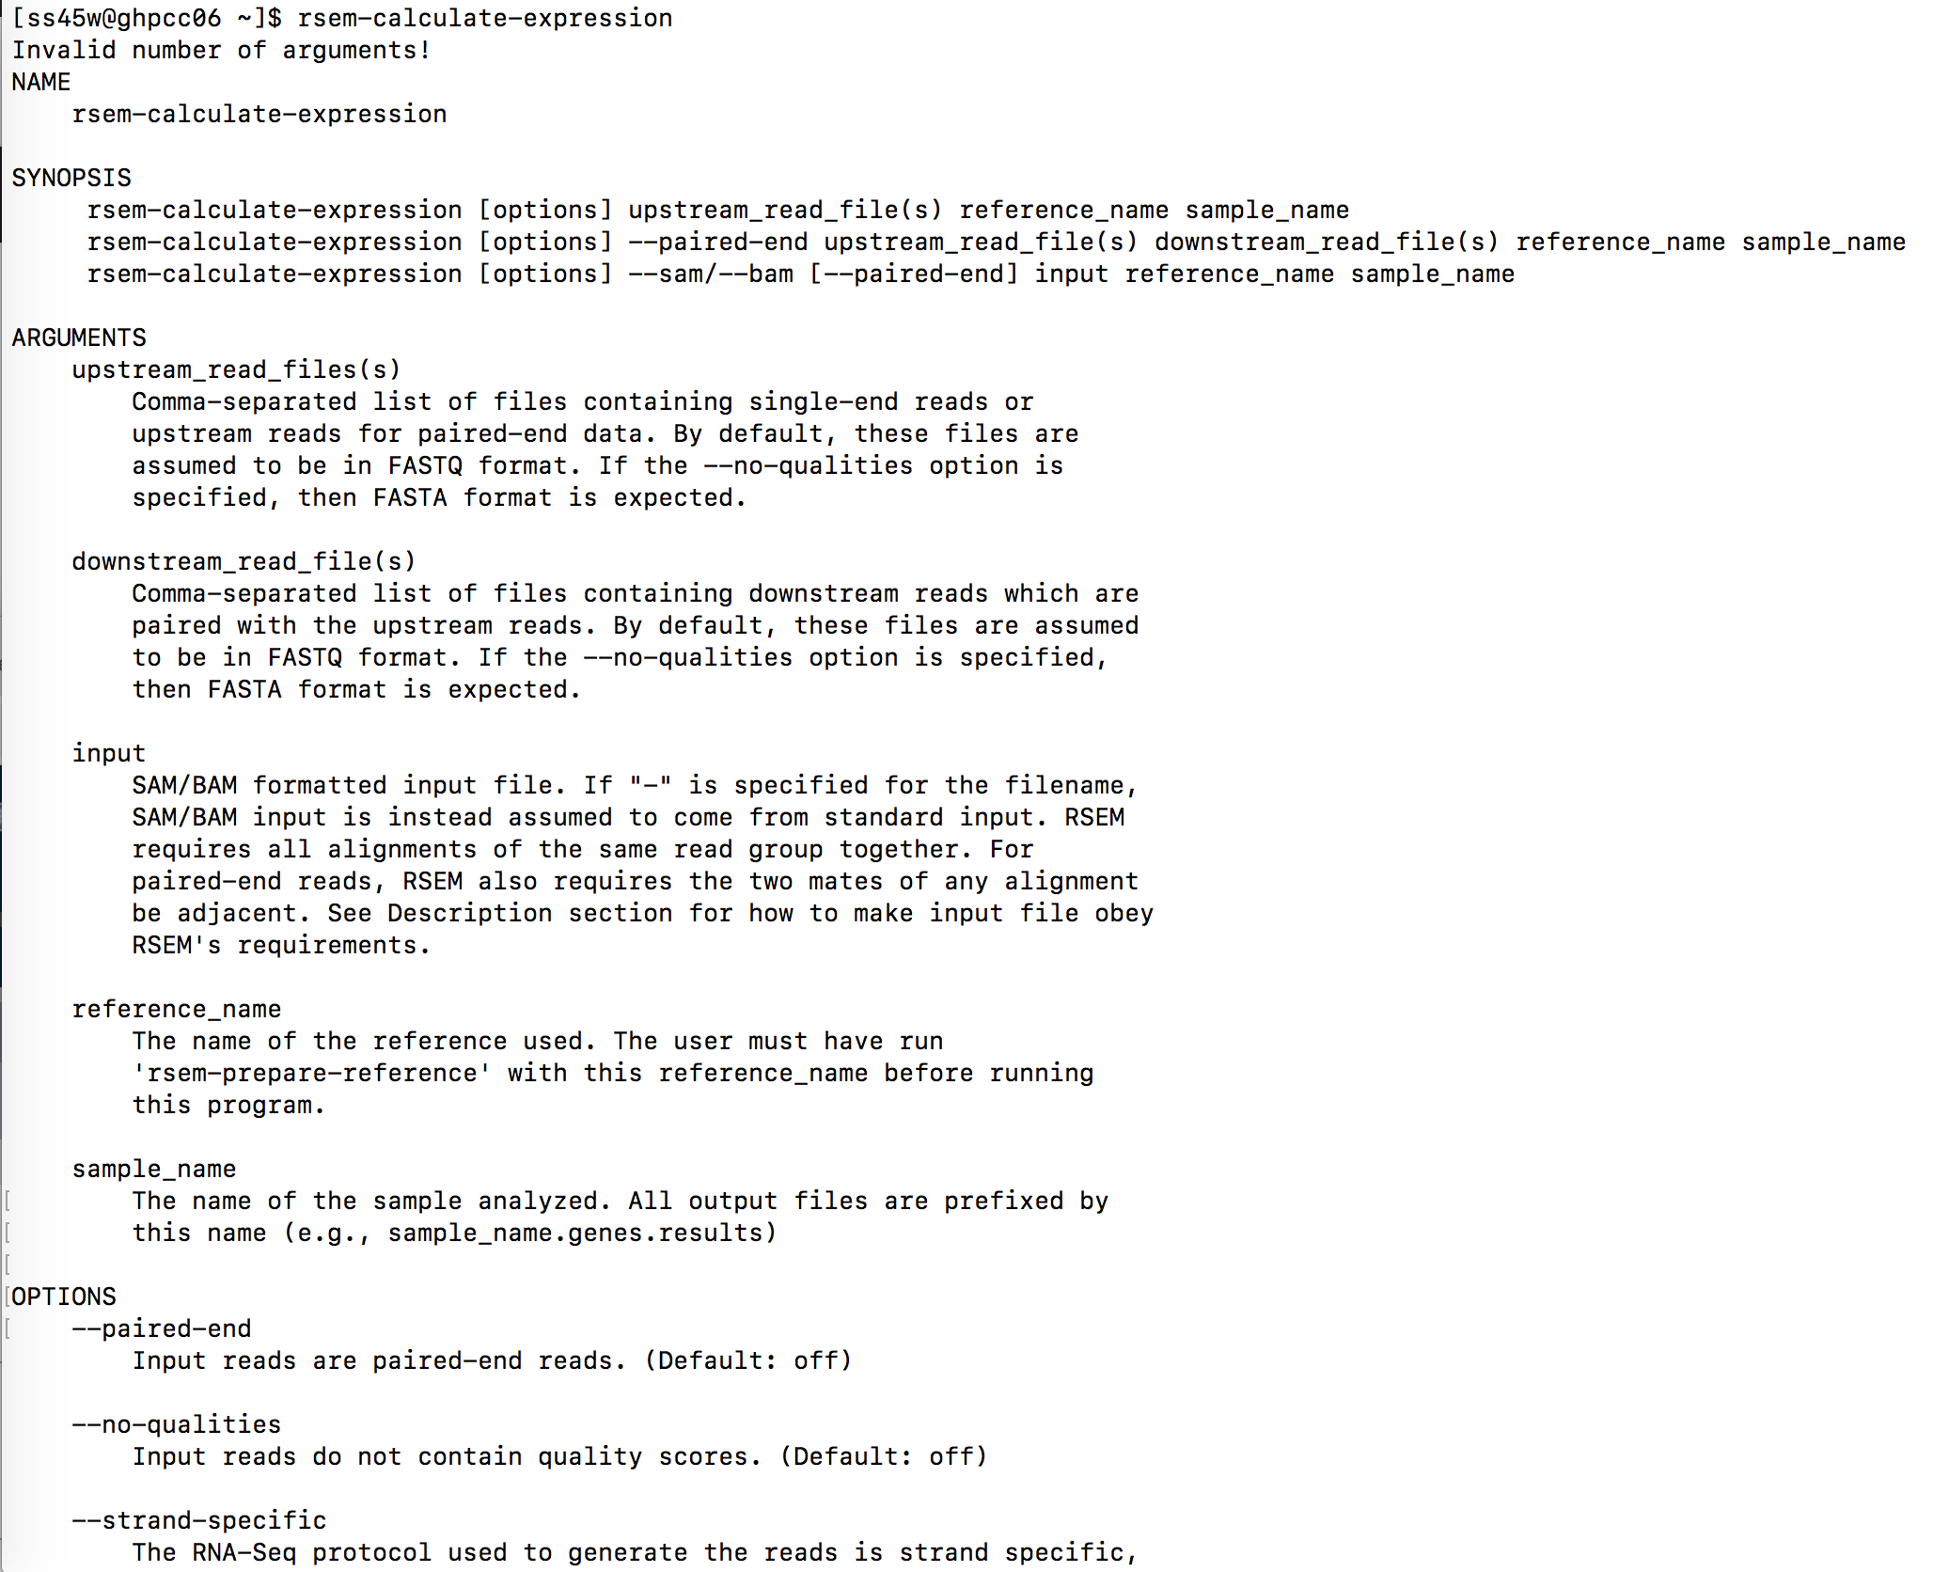

Slide 29
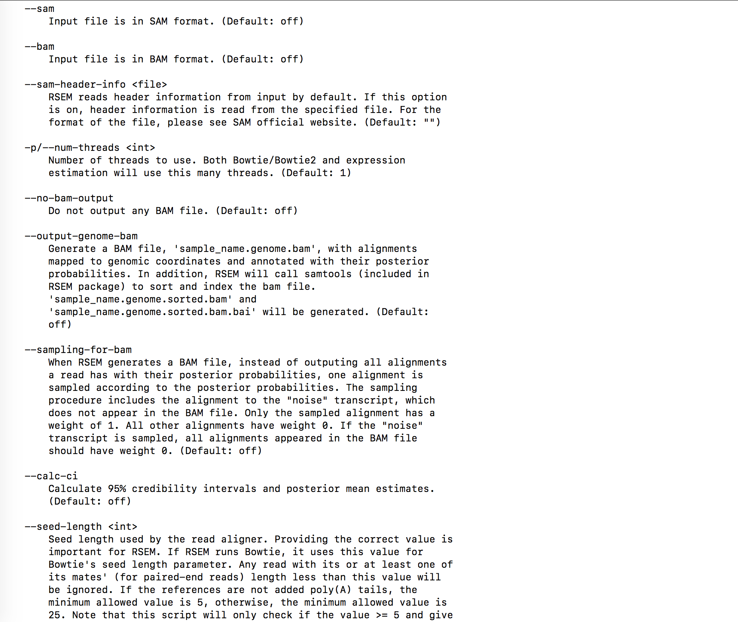

Slide 30
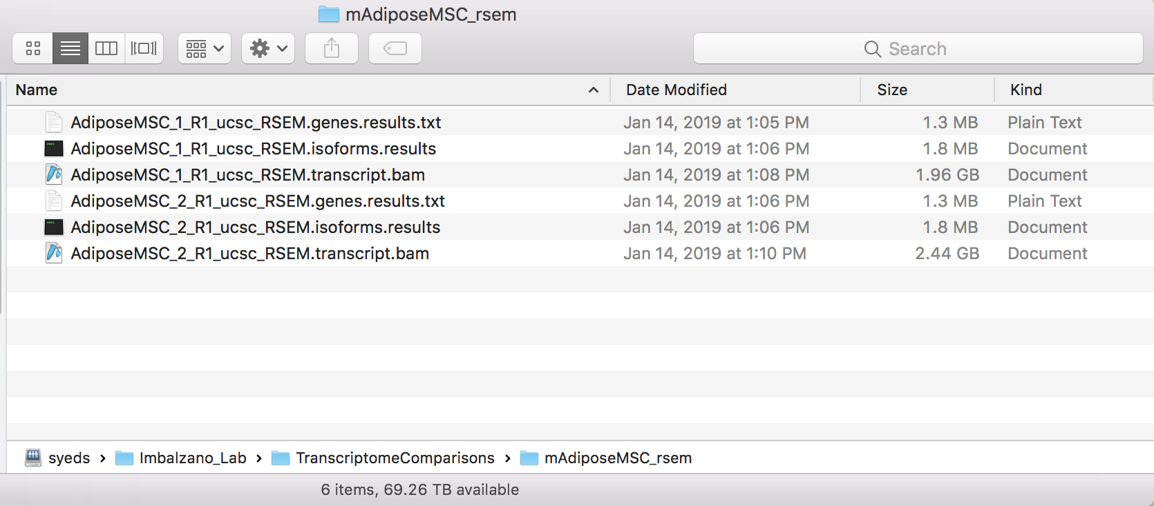
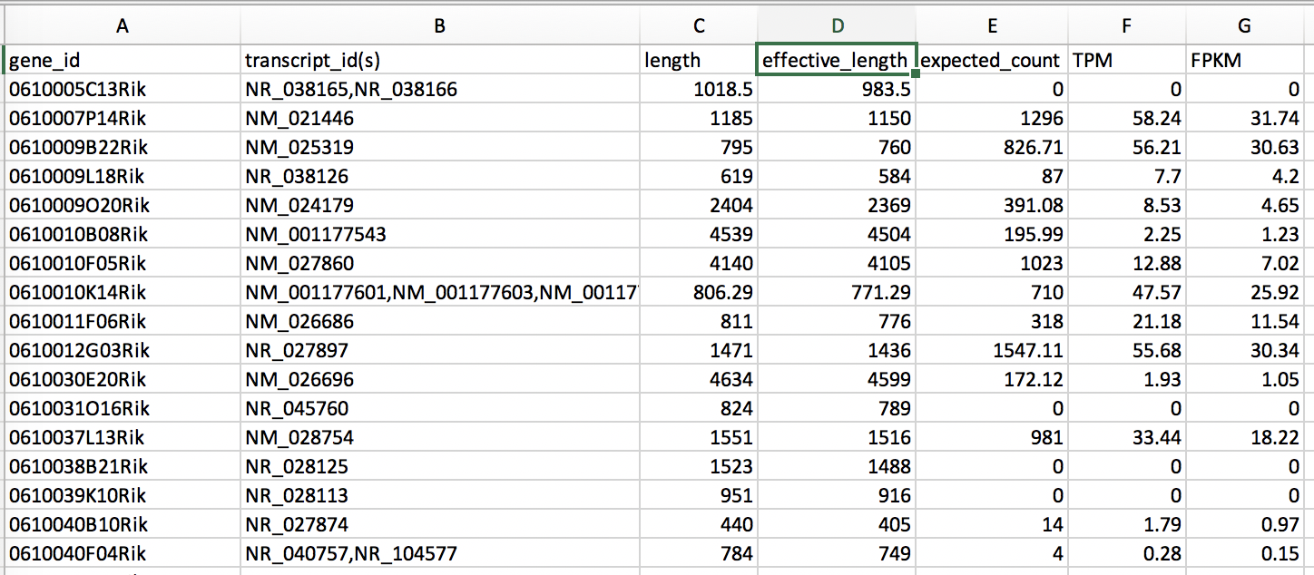
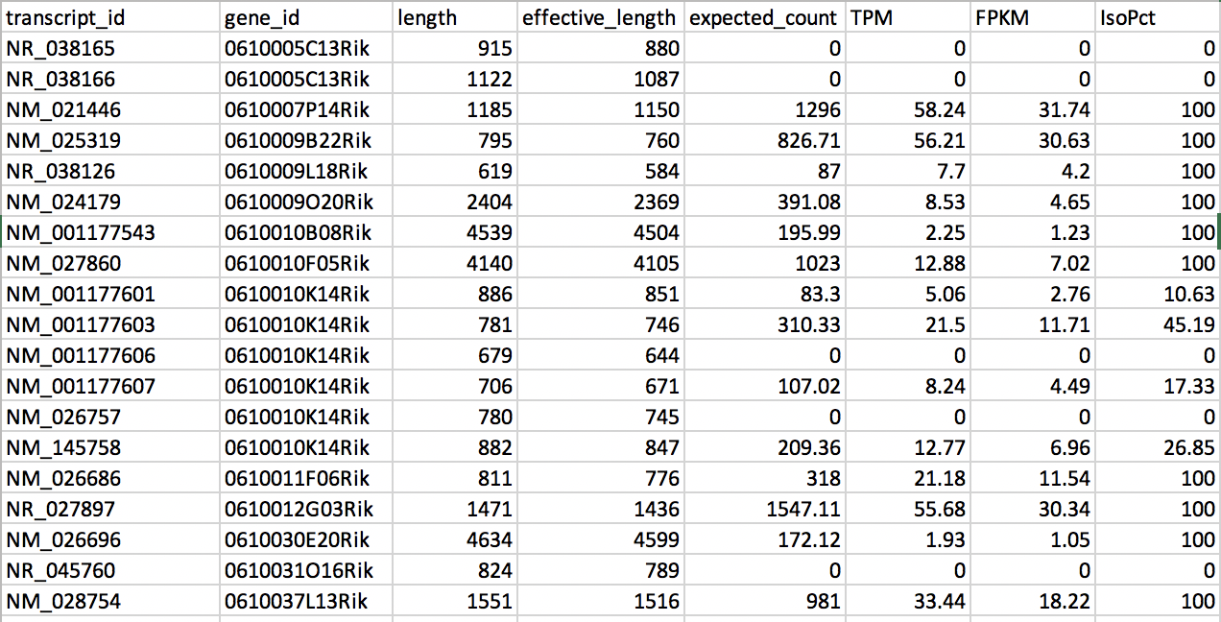
RSEM output
Gene results
Transcript variant results

Slide 31
RNA-Seq Pipline
Methods and Tools
Bowtie and Bowtie2 use Burrows-Wheeler indexing for aligning reads. With bowtie2 there is no upper limit on the read length
Bowtie2
Bowtie2 to align reads in a splice-aware manner and aids the discovery of new splice junctions
RSEM is a software package for estimating gene and isoform expression levels from RNA-Seq data. The RSEM package provides an user-friendly interface, supports threads for parallel computation of the EM algorithm, single-end and paired-end read data, quality scores, variable-length reads and RSPD estimation.

Slide 32
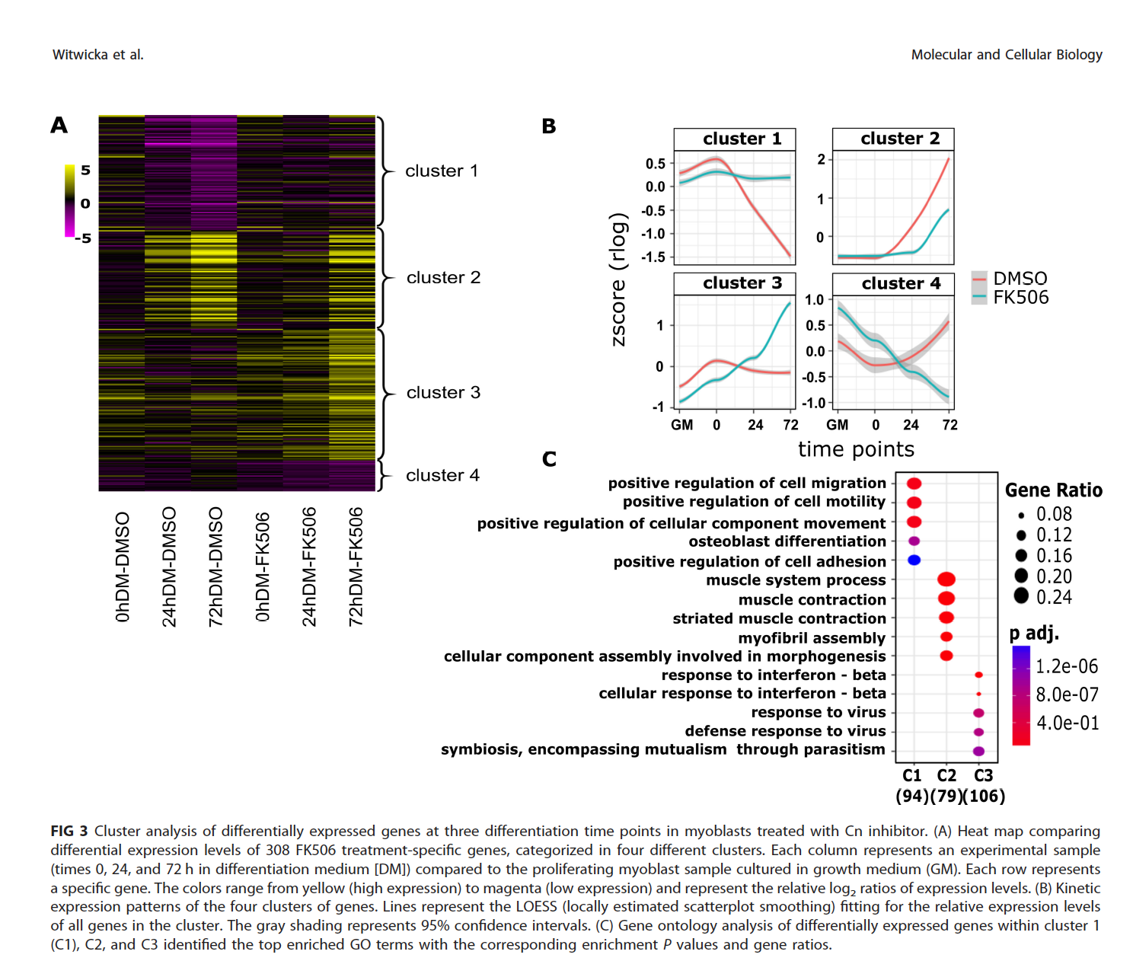
Differential Gene Expression analysis remains (week 6)
….then figures like this are possible

